Slide 1
Discrete Numeric Function (dnf), Generating Functions & Recurrence Relations

Slide 2
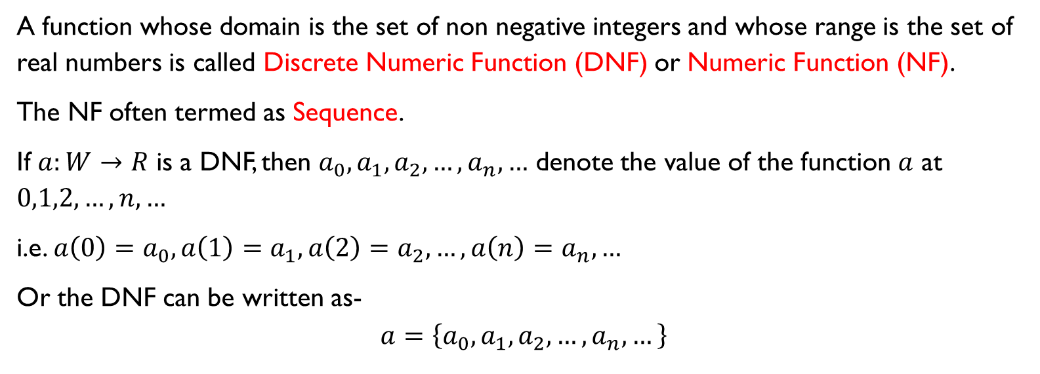
Discrete Numeric Function (DNF)
A function whose domain is the set of non negative integers and whose range is the set of real numbers is called Discrete Numeric Function (DNF) or Numeric Function (NF).
The NF often termed as Sequence.
If $a:W→R$ is a DNF, then $a_{0},a_{1},a_{2},…,a_{n},…$ denote the value of the function $a$ at $0,1,2,…,n,…$
i.e. $a\left(0\right)=a_{0},a\left(1\right)=a_{1},a\left(2\right)=a_{2},…,a\left(n\right)=a_{n},…$
Or the DNF can be written as-
$$a=\left\{a_{0},a_{1},a_{2},…,a_{n},…\right\}$$

Slide 3
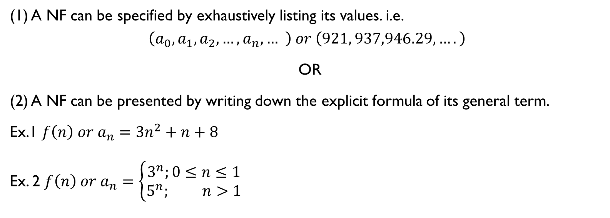
Representation of NF
(1) A NF can be specified by exhaustively listing its values. i.e.
$$\left(a_{0},a_{1},a_{2},…,a_{n},… \right) or \left(921, 937,946.29,….\right)$$
OR
(2) A NF can be presented by writing down the explicit formula of its general term.
Ex.1 $f\left(n\right) or a_{n}=3n^{2}+n+8$
Ex. 2 $f\left(n\right) or a_{n}=\left\{\begin{aligned}3^{n};0≤n≤1 \\ 5^{n}; n>1\end{aligned}\right.$

Slide 4
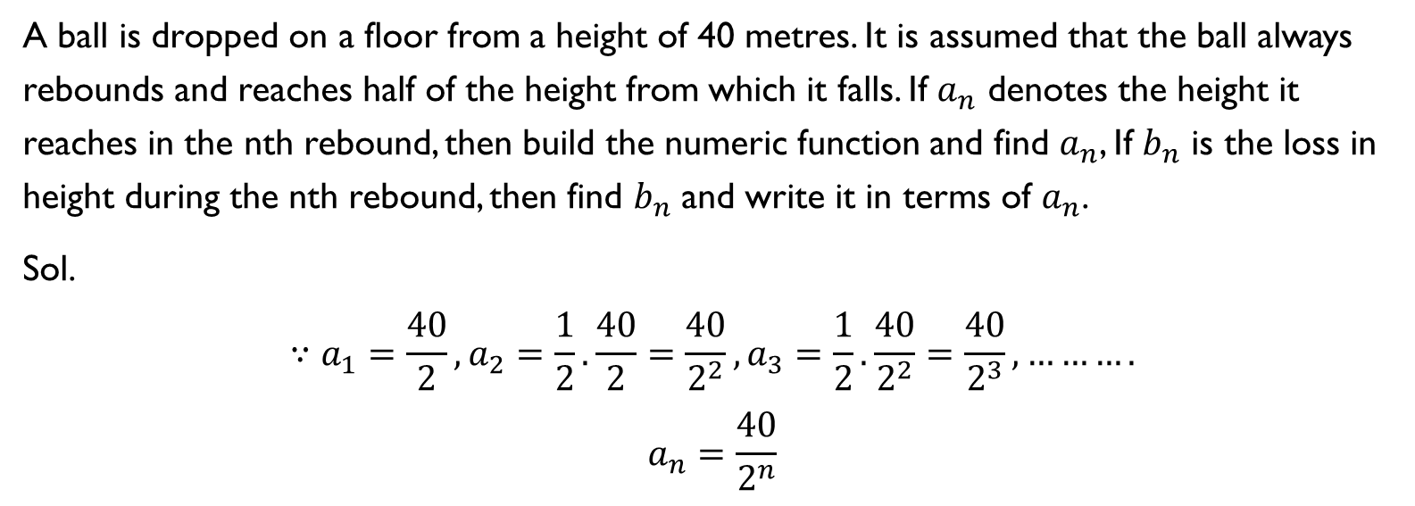
Example
A ball is dropped on a floor from a height of 40 metres. It is assumed that the ball always rebounds and reaches half of the height from which it falls. If $a_{n}$ denotes the height it reaches in the nth rebound, then build the numeric function and find $a_{n}$, If $b_{n}$ is the loss in height during the nth rebound, then find $b_{n}$ and write it in terms of $a_{n}$.
Sol.
$$∵a_{1}=\frac{40}{2},a_{2}=\frac{1}{2}.\frac{40}{2}=\frac{40}{2^{2}},a_{3}=\frac{1}{2}.\frac{40}{2^{2}}=\frac{40}{2^{3}}, ……….$$
$$a_{n}=\frac{40}{2^{n}}$$

Slide 5

$$∵b_{1}=40−\frac{40}{2},b_{2}=40−\frac{40}{2^{2}},b_{3}=40−\frac{40}{2^{3}},…..$$
$${∴b}_{n}=40−\frac{40}{2^{n}}$$

Slide 6
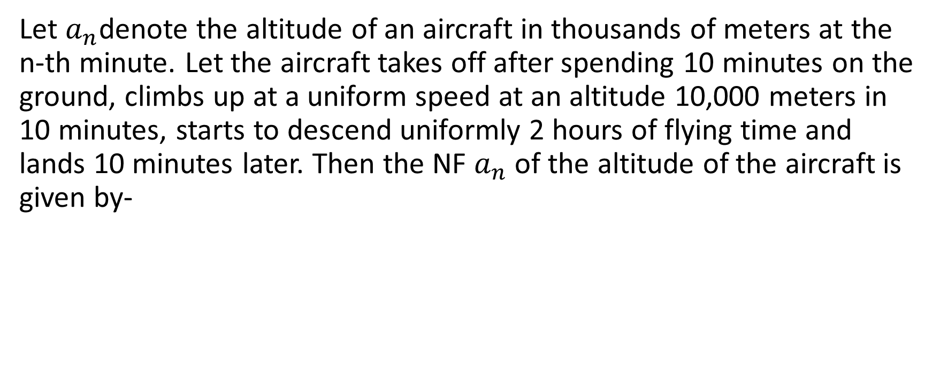
Example
Let $a_{n}$denote the altitude of an aircraft in thousands of meters at the n-th minute. Let the aircraft takes off after spending 10 minutes on the ground, climbs up at a uniform speed at an altitude 10,000 meters in 10 minutes, starts to descend uniformly 2 hours of flying time and lands 10 minutes later. Then the NF $a_{n}$ of the altitude of the aircraft is given by-

Slide 7
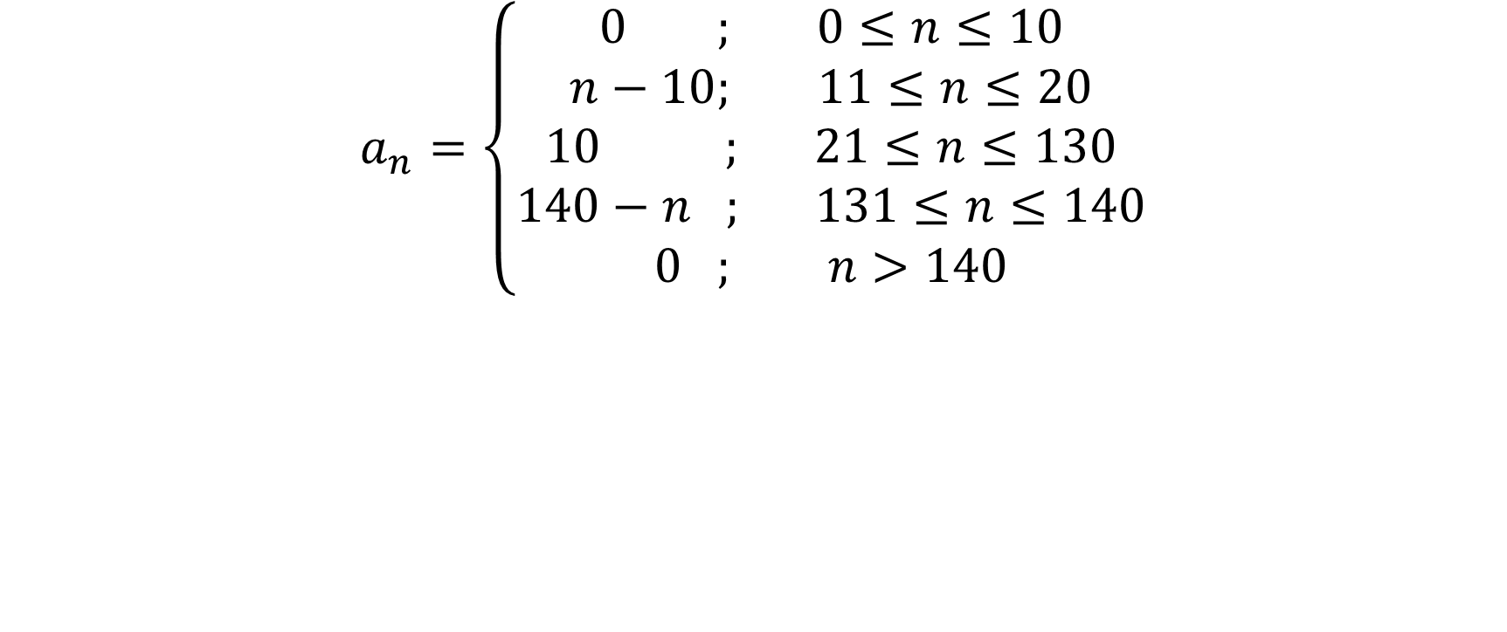
$$a_{n}=\left\{\begin{aligned}0 ; 0≤n≤10 \\ n−10; 11≤n≤20 \\ 10 ; 21≤n≤130 \\ 140−n ; 131≤n≤140 \\ 0 ; n>140\end{aligned}\right.$$

Slide 8
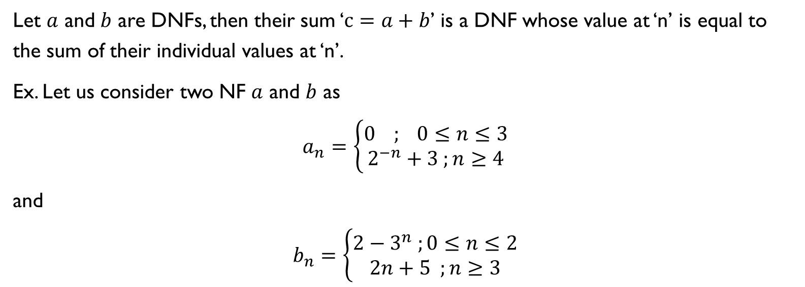
Sum of DNFs
Let $a$ and $b$ are DNFs, then their sum ‘$c=a+b$’ is a DNF whose value at ‘n’ is equal to the sum of their individual values at ‘n’.
Ex. Let us consider two NF $a$ and $b$ as
$$a_{n}=\left\{\begin{aligned}0 ; 0≤n≤3 \\ 2^{−n}+3 ;n≥4\end{aligned}\right.$$
and
$$b_{n}=\left\{\begin{aligned}2−3^{n} ;0≤n≤2 \\ 2n+5 ;n≥3\end{aligned}\right.$$

Slide 9

$$c_{n}=a_{n}+b_{n}=\left\{\begin{aligned}0+\left(2−3^{n}\right);0≤n≤2 \\ 0+\left(2×3+5\right);n=3 \\ \left(2^{−n}+3\right)+\left(2n+5\right);n≥4\end{aligned}\right.$$
$$=\left\{\begin{aligned}2−3^{n};0≤n≤2 \\ 11;n=3 \\ 2^{−n}+2n+8;n≥4\end{aligned}\right.$$

Slide 10
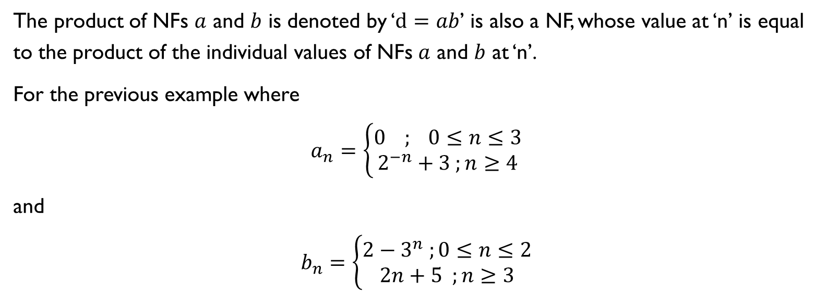
Product of DNFs
The product of NFs $a$ and $b$ is denoted by ‘$d=ab$’ is also a NF, whose value at ‘n’ is equal to the product of the individual values of NFs $a$ and $b$ at ‘n’.
For the previous example where
$$a_{n}=\left\{\begin{aligned}0 ; 0≤n≤3 \\ 2^{−n}+3 ;n≥4\end{aligned}\right.$$
and
$$b_{n}=\left\{\begin{aligned}2−3^{n} ;0≤n≤2 \\ 2n+5 ;n≥3\end{aligned}\right.$$

Slide 11
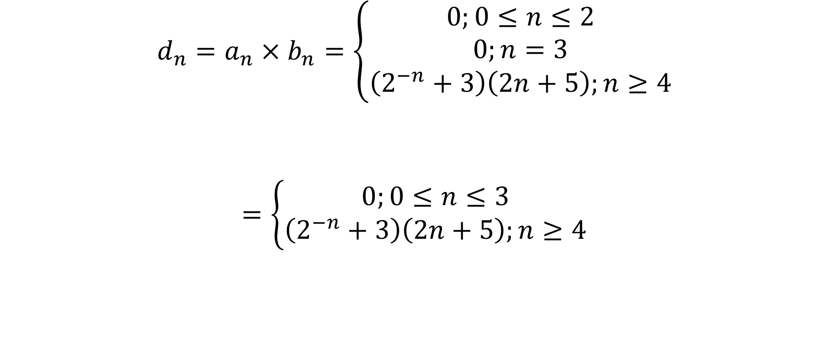
$$d_{n}=a_{n}×b_{n}=\left\{\begin{aligned}0;0≤n≤2 \\ 0;n=3 \\ \left(2^{−n}+3\right)\left(2n+5\right);n≥4\end{aligned}\right.$$
$$=\left\{\begin{aligned}0;0≤n≤3 \\ \left(2^{−n}+3\right)\left(2n+5\right);n≥4\end{aligned}\right.$$

Slide 12
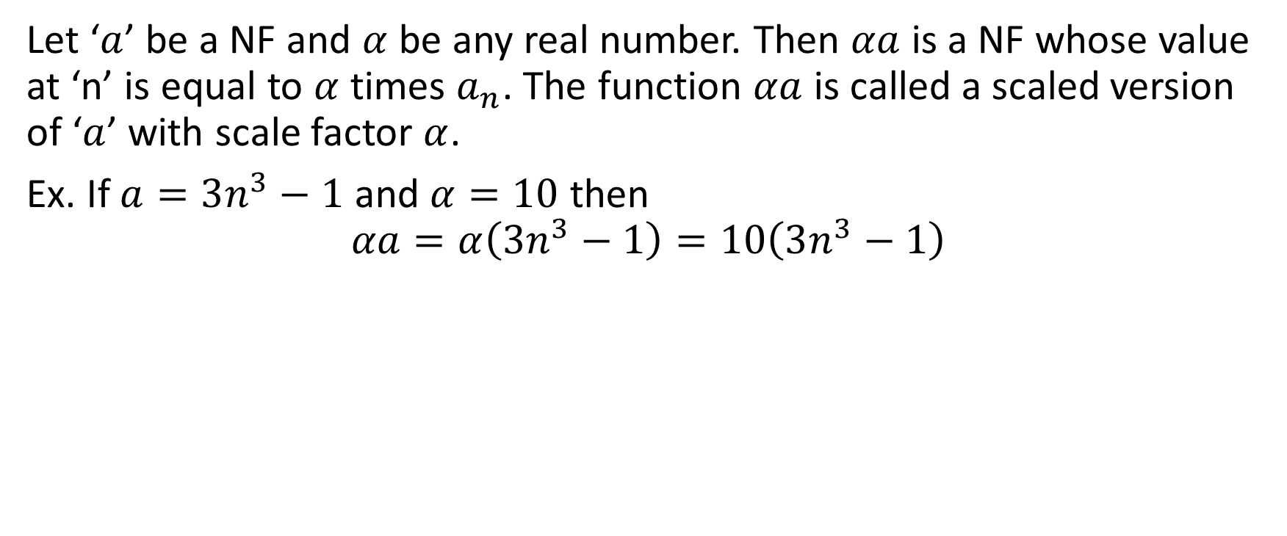
Multiplication of a NF by a Real Number
Let ‘$a$’ be a NF and $α$ be any real number. Then $αa$ is a NF whose value at ‘n’ is equal to $α$ times $a_{n}$. The function $αa$ is called a scaled version of ‘$a$’ with scale factor $α$.
Ex. If $a=3n^{3}−1$ and $α=10$ then
$$αa=α\left(3n^{3}−1\right)=10\left(3n^{3}−1\right)$$

Slide 13
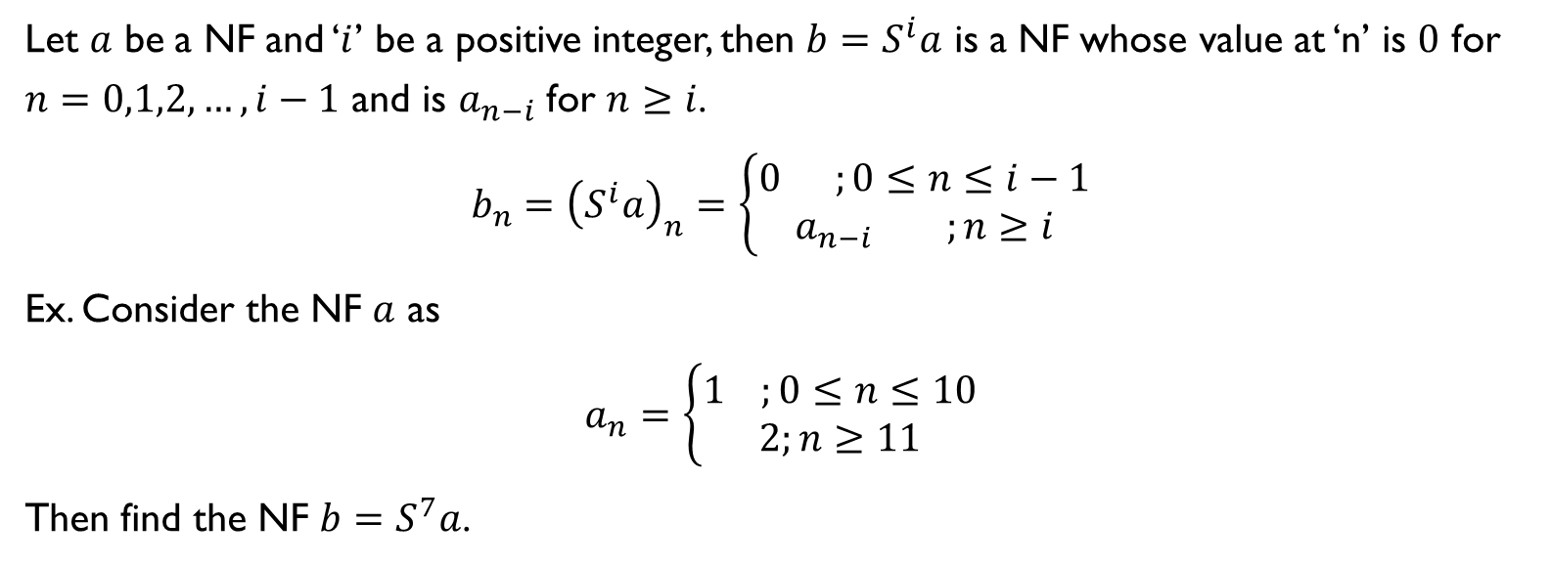
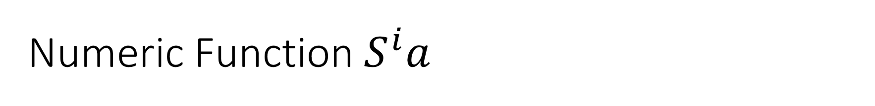
Numeric Function $S^{i}a$
Let $a$ be a NF and ‘$i$’ be a positive integer, then ${b=S}^{i}a$ is a NF whose value at ‘n’ is $0$ for $n=0,1,2,…,i−1$ and is $a_{n−i}$ for $n≥i$.
$$b_{n}={\left(S^{i}a\right)}_{n}=\left\{\begin{aligned}0 ;0≤n≤i−1 \\ a_{n−i };n≥i\end{aligned}\right.$$
Ex. Consider the NF $a$ as
$$a_{n}=\left\{\begin{aligned}1 ;0≤n≤10 \\ 2;n≥11\end{aligned}\right.$$
Then find the NF ${b=S}^{7}a$.

Slide 14
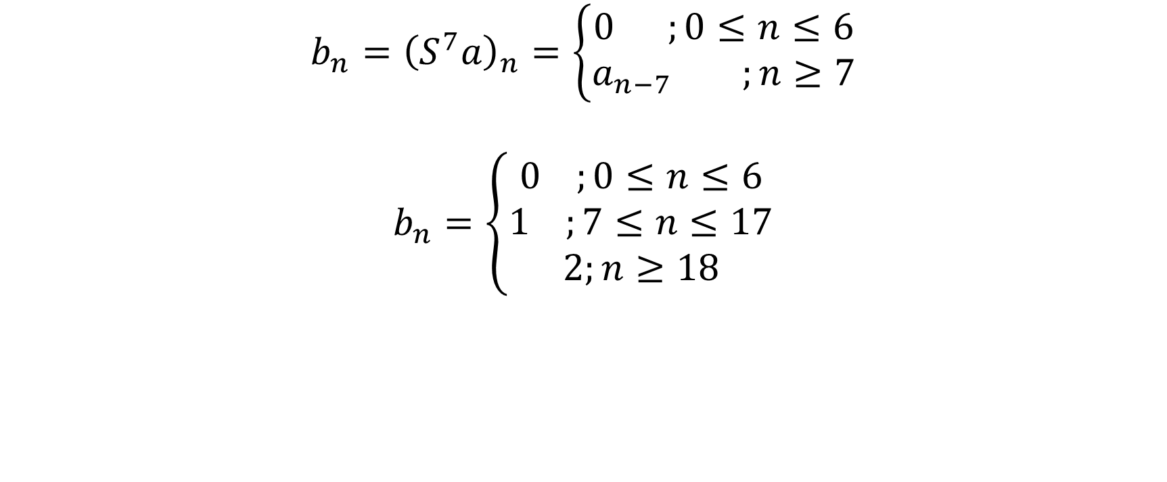
Solution
$$b_{n}={\left(S^{7}a\right)}_{n}=\left\{\begin{aligned}0 ;0≤n≤6 \\ a_{n−7 };n≥7\end{aligned}\right.$$
$$b_{n}=\left\{\begin{aligned}0 ;0≤n≤6 \\ 1 ;7≤n≤17 \\ 2;n≥18\end{aligned}\right.$$

Slide 15
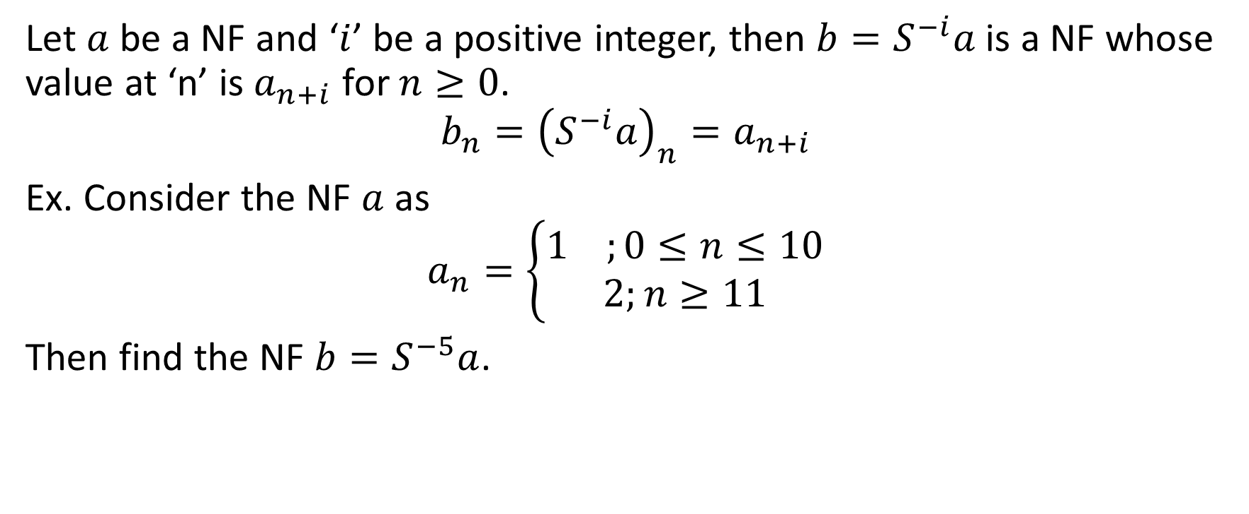
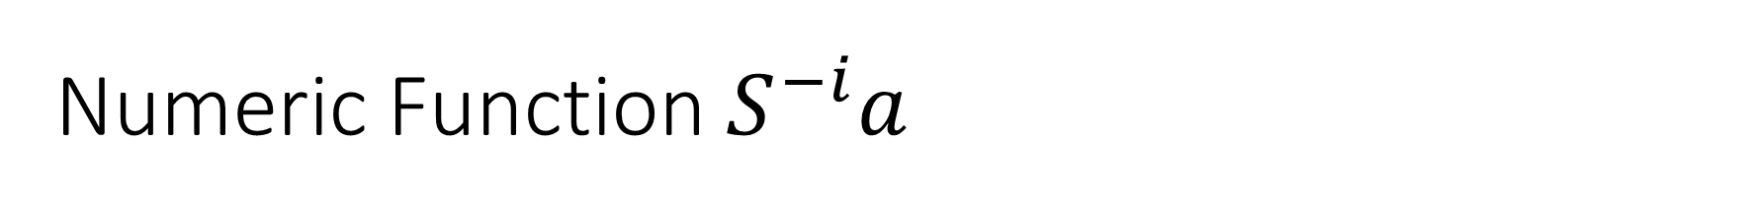
Numeric Function $S^{−i}a$
Let $a$ be a NF and ‘$i$’ be a positive integer, then ${b=S}^{−i}a$ is a NF whose value at ‘n’ is $a_{n+i}$ for $n≥0$.
$$b_{n}={\left(S^{−i}a\right)}_{n}=a_{n+i}$$
Ex. Consider the NF $a$ as
$$a_{n}=\left\{\begin{aligned}1 ;0≤n≤10 \\ 2;n≥11\end{aligned}\right.$$
Then find the NF ${b=S}^{−5}a$.

Slide 16
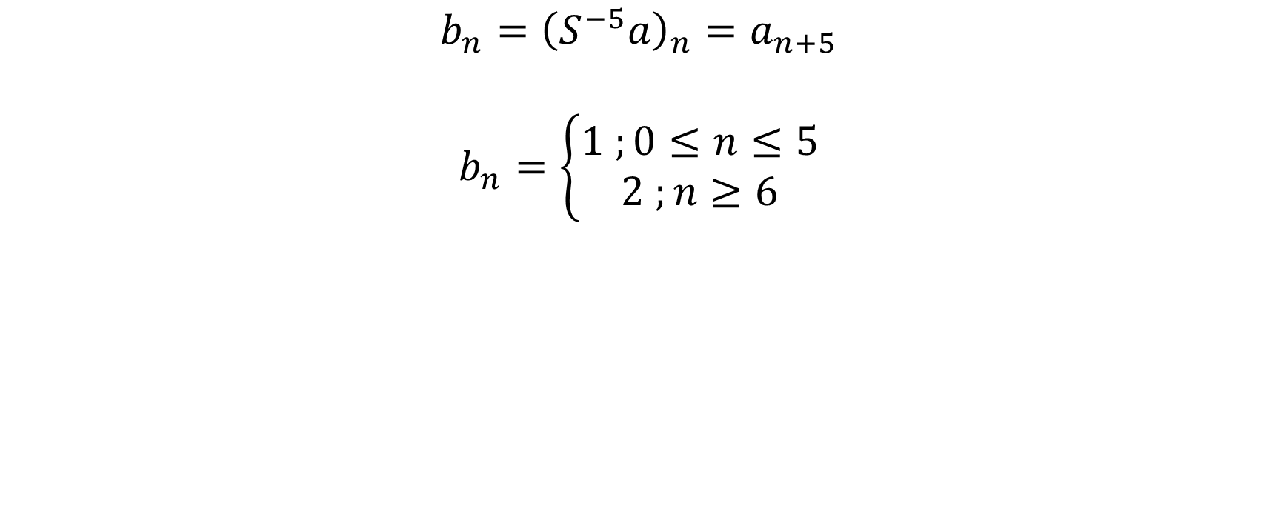
Solution
$$b_{n}={\left(S^{−5}a\right)}_{n}=a_{n+5}$$
$$b_{n}=\left\{\begin{aligned}1 ;0≤n≤5 \\ 2 ;n≥6\end{aligned}\right.$$

Slide 17
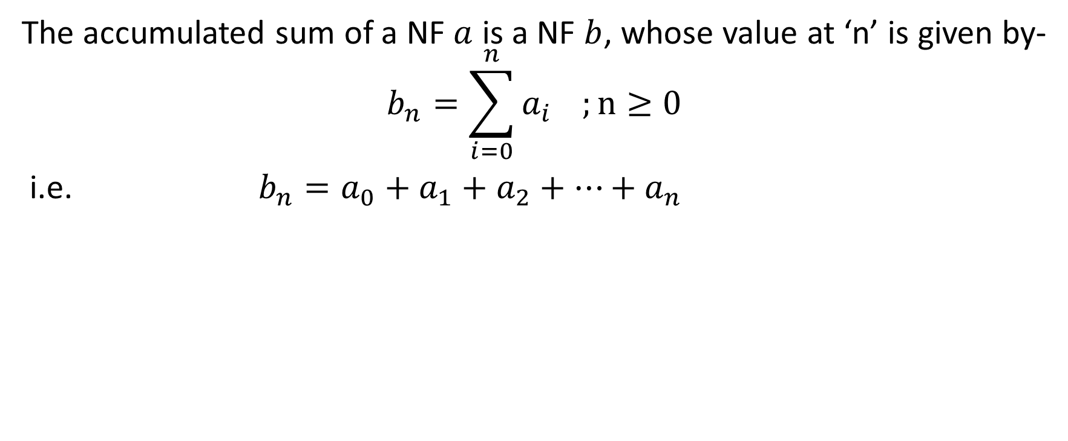
Accumulated Sum of a NF
The accumulated sum of a NF $a$ is a NF $b$, whose value at ‘n’ is given by-
$$b_{n}=\sum_{i=0}^{n}{a_{i}} ;n≥0$$
i.e. ${{b_{n}=a_{0}+a_{1}+a}_{2}+…+a}_{n}$

Slide 18
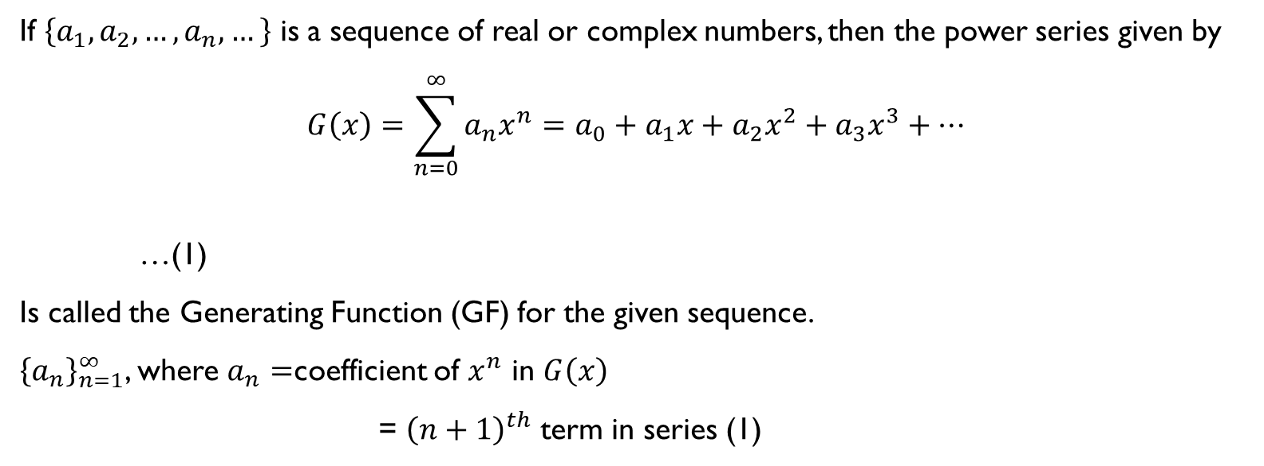
Generating Function (GF)
If $\left\{a_{1},a_{2},…,a_{n},…\right\}$ is a sequence of real or complex numbers, then the power series given by
$$G\left(x\right)=\sum_{n=0}^{∞}{a_{n}x^{n}}=a_{0}+a_{1}x+a_{2}x^{2}+a_{3}x^{3}+…$$
…(1)
Is called the Generating Function (GF) for the given sequence.
${\left\{a_{n}\right\}}_{n=1}^{∞}$, where $a_{n}=$coefficient of $x^{n}$ in $G\left(x\right)$
= ${\left(n+1\right)}^{th}$ term in series (1)

Slide 19
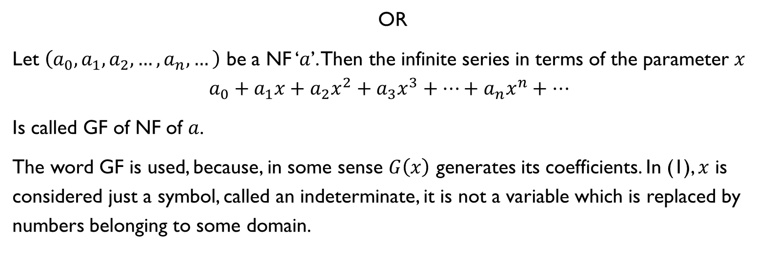
OR
Let $\left(a_{0},a_{1},a_{2},…,a_{n},…\right)$ be a NF ‘$a$’. Then the infinite series in terms of the parameter $x$
$$a_{0}+a_{1}x+a_{2}x^{2}+a_{3}x^{3}+…+a_{n}x^{n}+…$$
Is called GF of NF of $a$.
The word GF is used, because, in some sense $G\left(x\right)$ generates its coefficients. In (1), $x$ is considered just a symbol, called an indeterminate, it is not a variable which is replaced by numbers belonging to some domain.

Slide 20
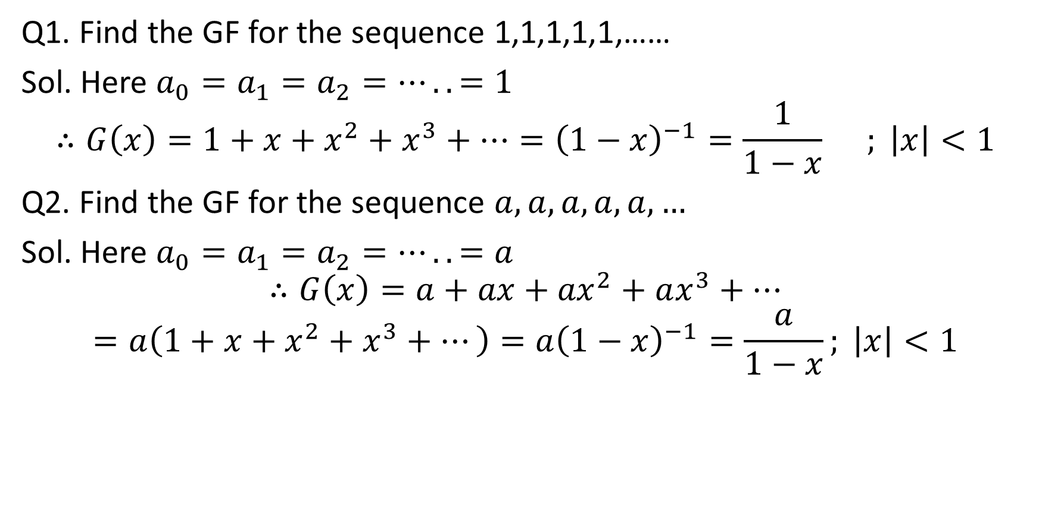
Q1. Find the GF for the sequence 1,1,1,1,1,……
Sol. Here $a_{0}=a_{1}=a_{2}=…..=1$
$$∴G\left(x\right)=1+x+x^{2}+x^{3}+…={\left(1−x\right)}^{−1}=\frac{1}{1−x} ; \left|x\right|<1$$
Q2. Find the GF for the sequence $a,a,a,a,a,…$
Sol. Here $a_{0}=a_{1}=a_{2}=…..=a$
$$∴G\left(x\right)=a+ax+{ax}^{2}+ax^{3}+…$$
$$=a\left(1+x+x^{2}+x^{3}+…\right)={a\left(1−x\right)}^{−1}=\frac{a}{1−x}; \left|x\right|<1$$

Slide 21

Q3.Find the GF for the sequence 1,2,3,4,5,……
Sol. Here $a_{0}=1,a_{1}=2,a_{2}=3,…$
$$∴G\left(x\right)=1+2x+3x^{2}+4x^{3}+…={\left(1−x\right)}^{−2}=\frac{1}{{\left(1−x\right)}^{2}}$$
Q4. Find the GF for the sequence 0,1,2,3,4,……
Sol. Here $a_{0}=0,a_{1}=1,a_{2}=2,…..$
$$∴G\left(x\right)=0+x+2x^{2}+3x^{3}+…=x(1+2x+3x^{2}+{4x}^{3}+…)$$
$$=x{\left(1−x\right)}^{−2}=\frac{x}{{\left(1−x\right)}^{2}}$$

Slide 22

Q5. Find the GF for the sequence $1,a,a^{2},a^{3},…$
Sol. Here $a_{0}=1,a_{1}=a,a_{2}=a^{2}…$
$$∴G\left(x\right)=1+ax+a^{2}x^{2}+a^{3}x^{3}+…$$
$$={\left(1−ax\right)}^{−1}=\frac{1}{1−ax}; \left|ax\right|<1$$
Alternative Way
$$G\left(x\right)=1+ax+a^{2}x^{2}+a^{3}x^{3}+…$$
$$⇒G\left(x\right)−1=ax+a^{2}x^{2}+a^{3}x^{3}+…$$
$$\frac{G\left(x\right)−1}{ax}=1+ax+a^{2}x^{2}+a^{3}x^{3}+…$$
$$\frac{G\left(x\right)−1}{ax}=G\left(x\right)$$
$$⇒G\left(x\right)=\frac{1}{1−ax}$$

Slide 23
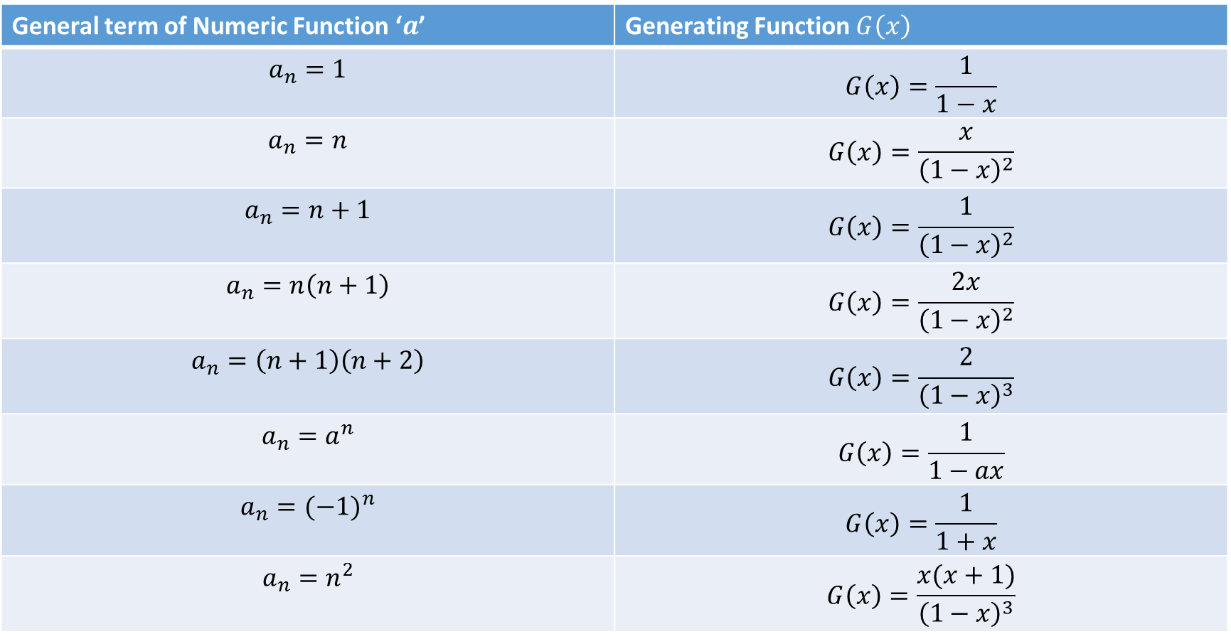
Generating Functions for some NFs
General term of Numeric Function ‘$a$’ | Generating Function $G\left(x\right)$
$$a_{n}=1$$ | $$G\left(x\right)=\frac{1}{1−x}$$
$$a_{n}=n$$ | $$G\left(x\right)=\frac{x}{{\left(1−x\right)}^{2}}$$
$$a_{n}=n+1$$ | $$G\left(x\right)=\frac{1}{{\left(1−x\right)}^{2}}$$
$$a_{n}=n\left(n+1\right)$$ | $$G\left(x\right)=\frac{2x}{{\left(1−x\right)}^{2}}$$
$$a_{n}=\left(n+1\right)\left(n+2\right)$$ | $$G\left(x\right)=\frac{2}{{\left(1−x\right)}^{3}}$$
$$a_{n}=a^{n}$$ | $$G\left(x\right)=\frac{1}{1−ax}$$
$$a_{n}={(−1)}^{n}$$ | $$G\left(x\right)=\frac{1}{1+x}$$
$$a_{n}=n^{2}$$ | $$G\left(x\right)=\frac{x(x+1)}{{\left(1−x\right)}^{3}}$$

Slide 24
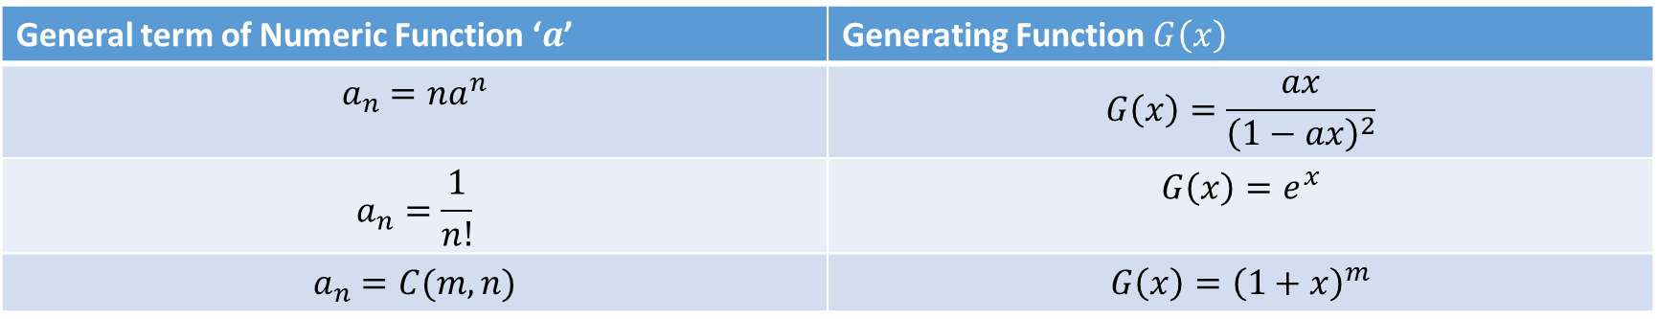
Generating Functions for some NFs
General term of Numeric Function ‘$a$’ | Generating Function $G\left(x\right)$
$$a_{n}=na^{n}$$ | $$G\left(x\right)=\frac{ax}{{\left(1−ax\right)}^{2}}$$
$$a_{n}=\frac{1}{n!}$$ | $$G\left(x\right)=e^{x}$$
$$a_{n}=C(m,n)$$ | $$G\left(x\right)={\left(1+x\right)}^{m}$$

Slide 25
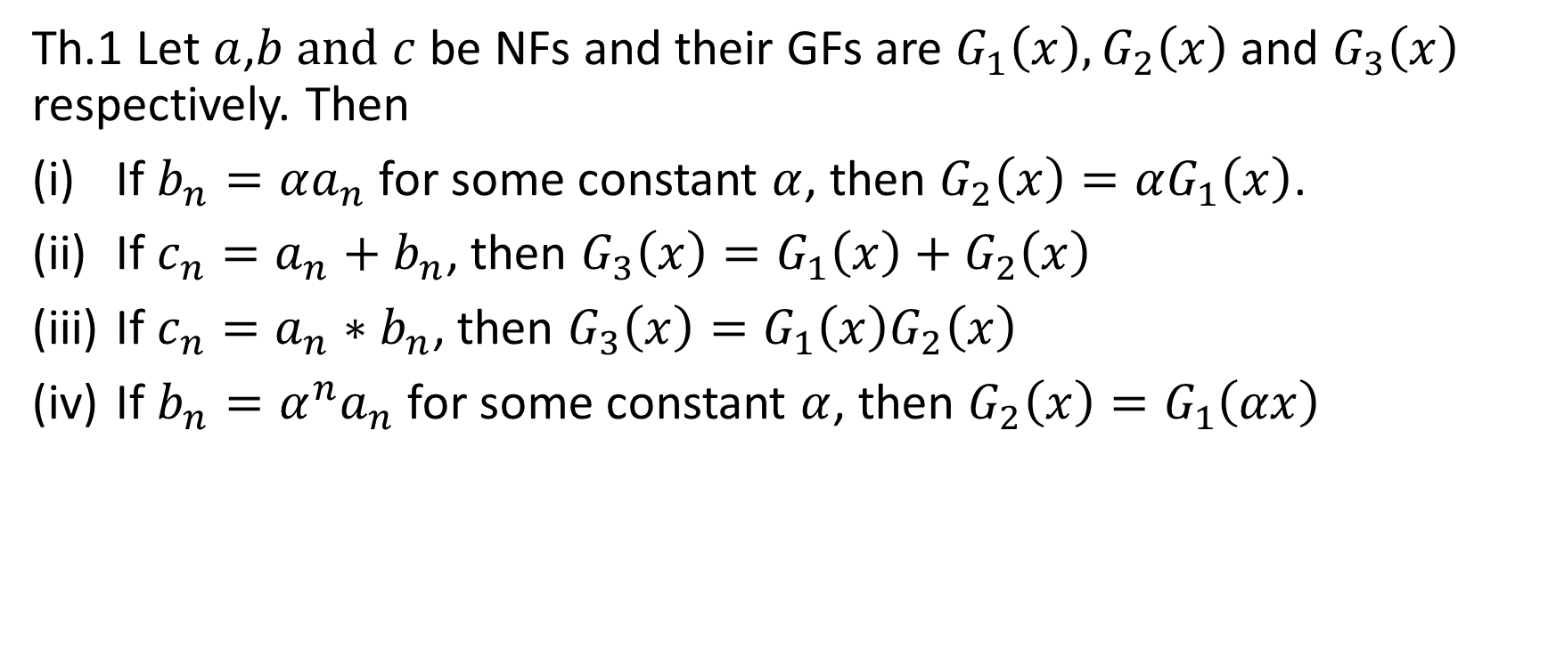
Addition and Multiplication of two GFs
Th.1 Let $a$,$b and$ $c$ be NFs and their GFs are $G_{1}\left(x\right),G_{2}\left(x\right)$ and $G_{3}\left(x\right)$ respectively. Then
If $b_{n}=αa_{n}$ for some constant $α$, then $G_{2}\left(x\right)=αG_{1}\left(x\right)$.
If $c_{n}=a_{n}+b_{n}$, then $G_{3}\left(x\right)=G_{1}\left(x\right)+G_{2}\left(x\right)$
If $c_{n}=a_{n}∗b_{n}$, then $G_{3}\left(x\right)=G_{1}\left(x\right)G_{2}\left(x\right)$
If $b_{n}=α^{n}a_{n}$ for some constant $α$, then $G_{2}\left(x\right)=G_{1}\left(αx\right)$

Slide 26
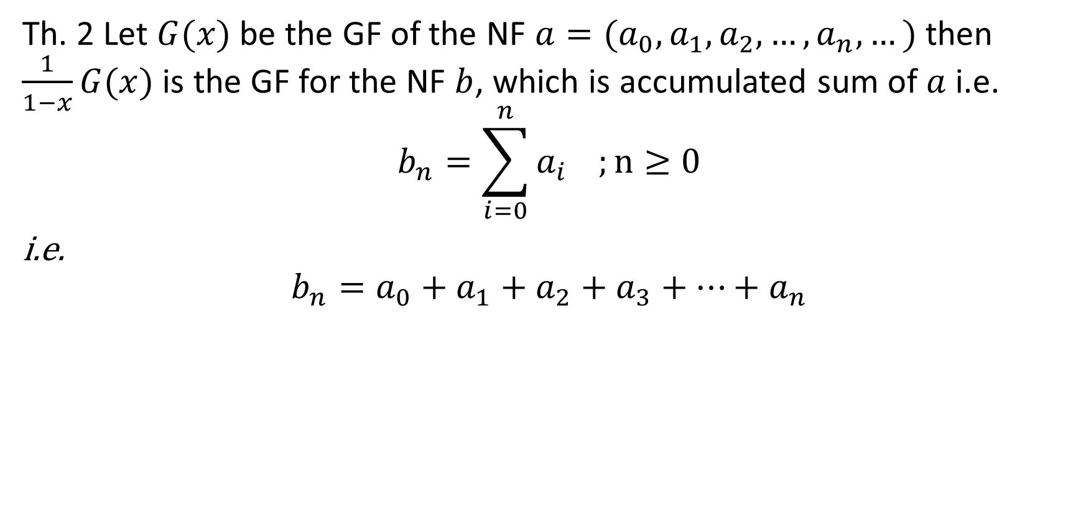
Th. 2 Let $G(x)$ be the GF of the NF $a=(a_{0},a_{1},a_{2},…,a_{n},…)$ then $\frac{1}{1−x}G(x)$ is the GF for the NF $b$, which is accumulated sum of $a$ i.e.
$$b_{n}=\sum_{i=0}^{n}{a_{i}} ;n≥0$$
i.e.
$$b_{n}=a_{0}+a_{1}+a_{2}+a_{3}+…+a_{n}$$

Slide 27

Proof:
$$∵G\left(x\right)=a_{0}+a_{1}x+a_{2}x^{2}+a_{3}x^{3}+…+a_{n}x^{n}+…$$
…(1)
Also $\frac{1}{1−x}=1+x+x^{2}+x^{3}+…+x^{n}+…$
…(2)
(1)X (2), we have
$$\frac{G(x)}{1−x}=\left(1+x+x^{2}+x^{3}+…+x^{n}+…\right)$$
$$∗(a_{0}+a_{1}x+a_{2}x^{2}+a_{3}x^{3}+…+a_{n}x^{n}+…)$$
$$=a_{0}+(a_{0}+a_{1})x+{(a_{0}+a_{1}+a}_{2})x^{2}+{{(a_{0}+a_{1}+a}_{2}+a}_{3}{)x}^{3}+…+{{(a_{0}+a_{1}+a}_{2}+…+a}_{n})x^{n}+…$$
$$=b_{0}+b_{1}x+b_{2}x^{2}+b_{3}x^{3}+…+b_{n}x^{n}+…$$
Where ${{b_{n}=a_{0}+a_{1}+a}_{2}+…+a}_{n}$

Slide 28
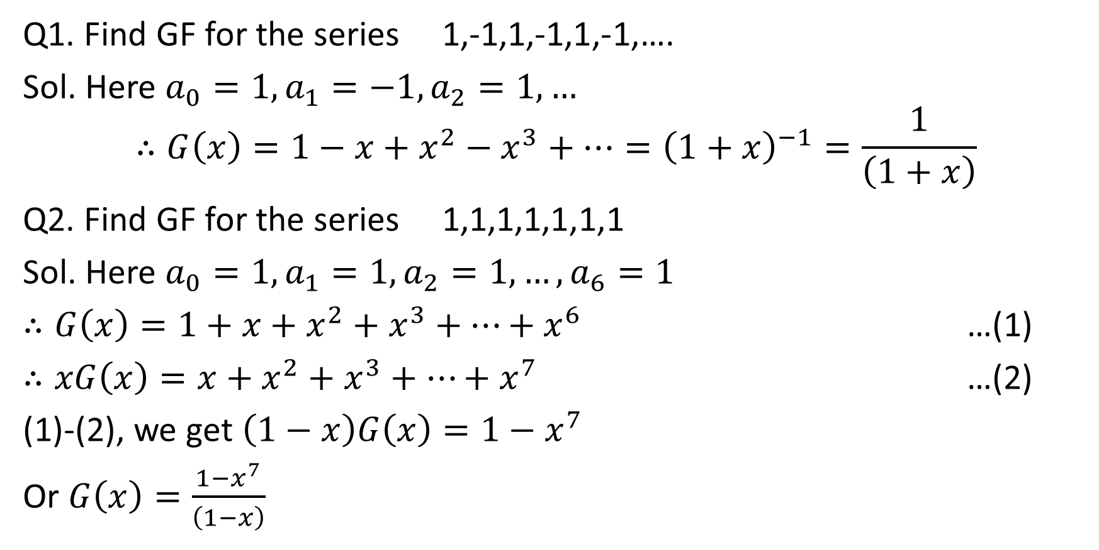
Q1. Find GF for the series 1,-1,1,-1,1,-1,….
Sol. Here $a_{0}=1,a_{1}=−1,a_{2}=1,…$
$$∴G\left(x\right)=1−x+x^{2}−x^{3}+…={\left(1+x\right)}^{−1}=\frac{1}{\left(1+x\right)}$$
Q2. Find GF for the series 1,1,1,1,1,1,1
Sol. Here $a_{0}=1,a_{1}=1,a_{2}=1,…,a_{6}=1$
$∴G\left(x\right)=1+x+x^{2}+x^{3}+…+x^{6}$ …(1)
$∴xG\left(x\right)=x+x^{2}+x^{3}+…+x^{7}$ …(2)
(1)-(2), we get $\left(1−x\right)G\left(x\right)=1−x^{7}$
Or $G\left(x\right)=\frac{1−x^{7}}{\left(1−x\right)}$

Slide 29
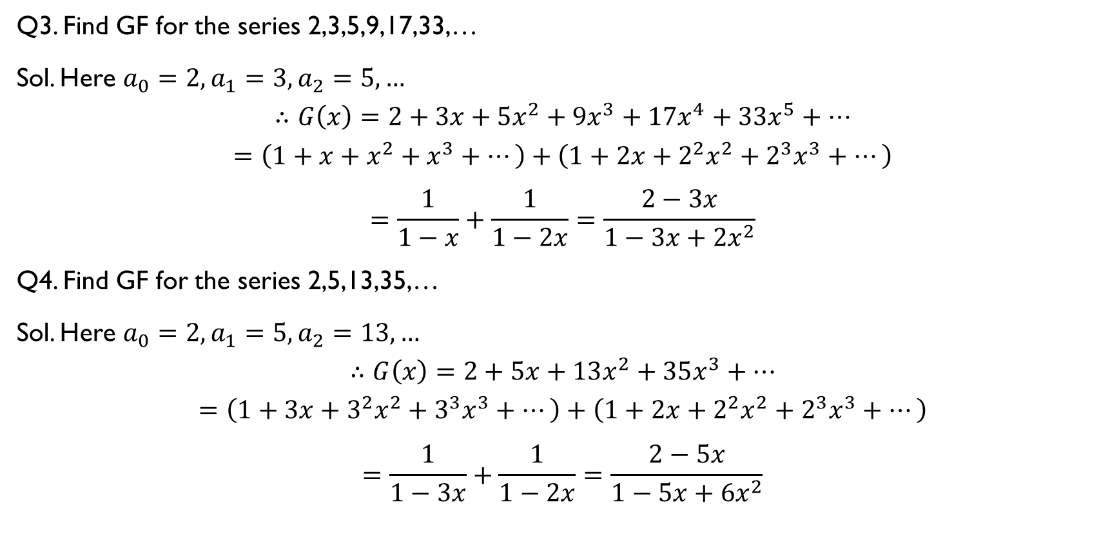
Q3. Find GF for the series 2,3,5,9,17,33,…
Sol. Here $a_{0}=2,a_{1}=3,a_{2}=5,…$
$$∴G\left(x\right)=2+3x+5x^{2}+9x^{3}+17x^{4}+33x^{5}+…$$
$$=\left(1+x+x^{2}+x^{3}+…\right)+\left(1+2x+2^{2}x^{2}+2^{3}x^{3}+…\right)$$
$$=\frac{1}{1−x}+\frac{1}{1−2x}=\frac{2−3x}{1−3x+2x^{2}}$$
Q4. Find GF for the series 2,5,13,35,…
Sol. Here $a_{0}=2,a_{1}=5,a_{2}=13,…$
$$∴G\left(x\right)=2+5x+13x^{2}+35x^{3}+…$$
$$=\left(1+3x+3^{2}x^{2}+{3^{3}x}^{3}+…\right)+\left(1+2x+2^{2}x^{2}+2^{3}x^{3}+…\right)$$
$$=\frac{1}{1−3x}+\frac{1}{1−2x}=\frac{2−5x}{1−5x+6x^{2}}$$

Slide 30

Q5. Find GF of a NF $a$, where
$a_{n}=\left\{\begin{aligned}2^{n} if n is even \\ −2^{n} if n is odd \\ 1 ;otherwise\end{aligned}\right.$
Sol. Here $G\left(x\right)=1−2x+2^{2}x^{2}−2^{3}x^{3}+2^{4}x^{4}−2^{5}x^{5}+…$
$$=\frac{1}{1+2x}$$

Slide 31
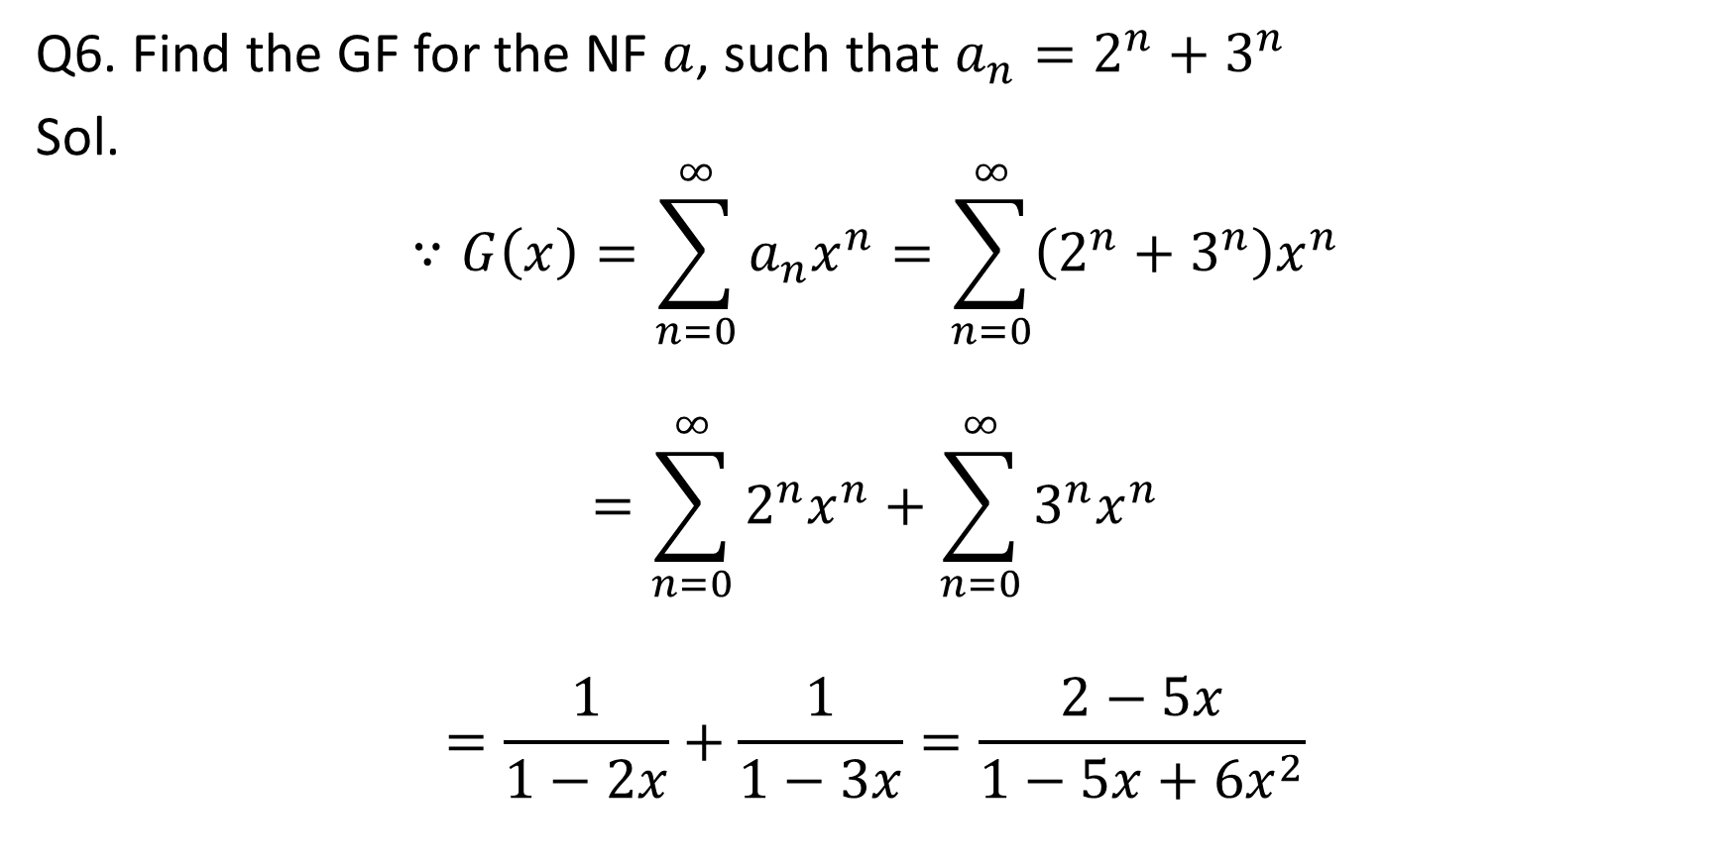
Q6. Find the GF for the NF $a$, such that $a_{n}=2^{n}+3^{n}$
Sol.
$$∵G\left(x\right)=\sum_{n=0}^{∞}{a_{n}x^{n}}=\sum_{n=0}^{∞}{\left(2^{n}+3^{n}\right)x^{n}}$$
$$=\sum_{n=0}^{∞}{2^{n}x^{n}}+\sum_{n=0}^{∞}{3^{n}x^{n}}$$
$$=\frac{1}{1−2x}+\frac{1}{1−3x}=\frac{2−5x}{1−5x+6x^{2}}$$

Slide 32
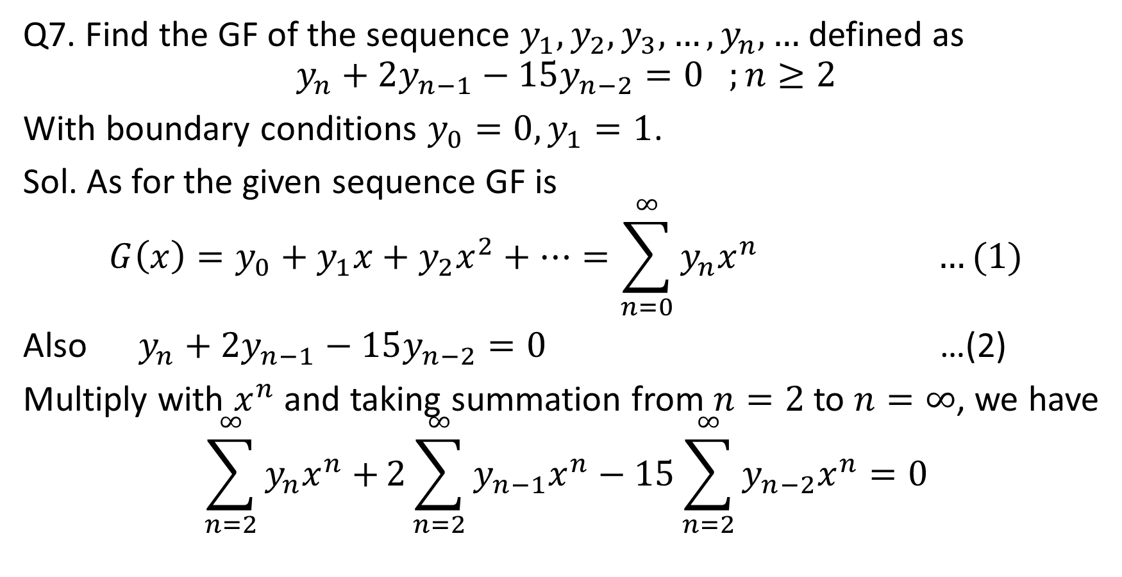
Q7. Find the GF of the sequence $y_{1},y_{2},y_{3},…,y_{n},…$ defined as
$$y_{n}+2y_{n−1}−15y_{n−2}=0 ;n≥2$$
With boundary conditions $y_{0}=0,y_{1}=1$.
Sol. As for the given sequence GF is
$$G\left(x\right)=y_{0}+y_{1}x+y_{2}x^{2}+…=\sum_{n=0}^{∞}{y_{n}x^{n}} …(1)$$
Also $y_{n}+2y_{n−1}−15y_{n−2}=0$ …(2)
Multiply with $x^{n}$ and taking summation from $n=2$ to $n=∞$, we have
$$\sum_{n=2}^{∞}{y_{n}x^{n}+}2\sum_{n=2}^{∞}{y_{n−1}x^{n}−15}\sum_{n=2}^{∞}{y_{n−2}x^{n}}=0$$

Slide 33
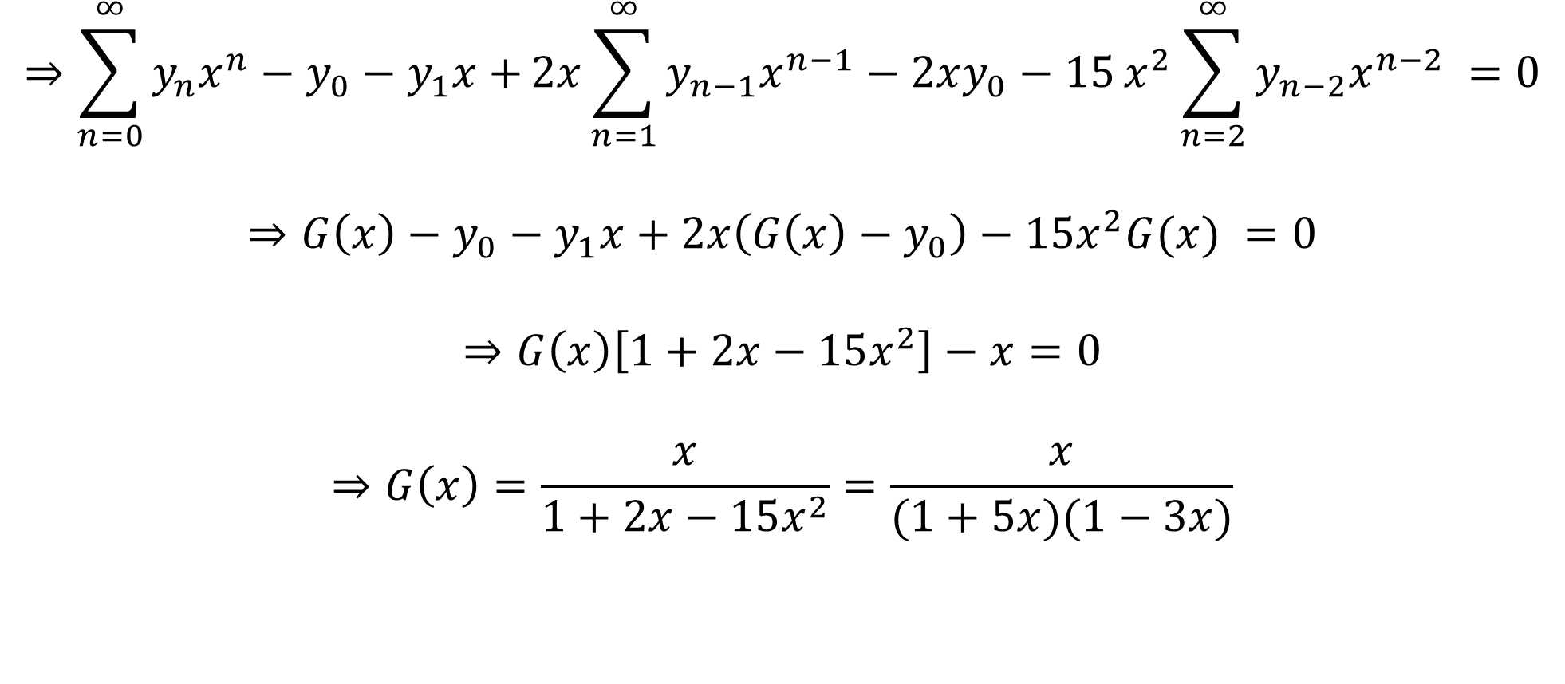
$$⇒\sum_{n=0}^{∞}{y_{n}x^{n}−y_{0}−y_{1}x+}2x\sum_{n=1}^{∞}{y_{n−1}x^{n−1}−2xy_{0}−15}x^{2}\sum_{n=2}^{∞}{y_{n−2}x^{n−2}} =0$$
$$⇒G\left(x\right)−y_{0}−y_{1}x+2x\left(G\left(x\right)−y_{0}\right)−15x^{2}G(x) =0$$
$$⇒G\left(x\right)\left[1+2x−15x^{2}\right]−x=0$$
$$⇒G\left(x\right)=\frac{x}{1+2x−15x^{2}}=\frac{x}{(1+5x)(1−3x)}$$

Slide 34
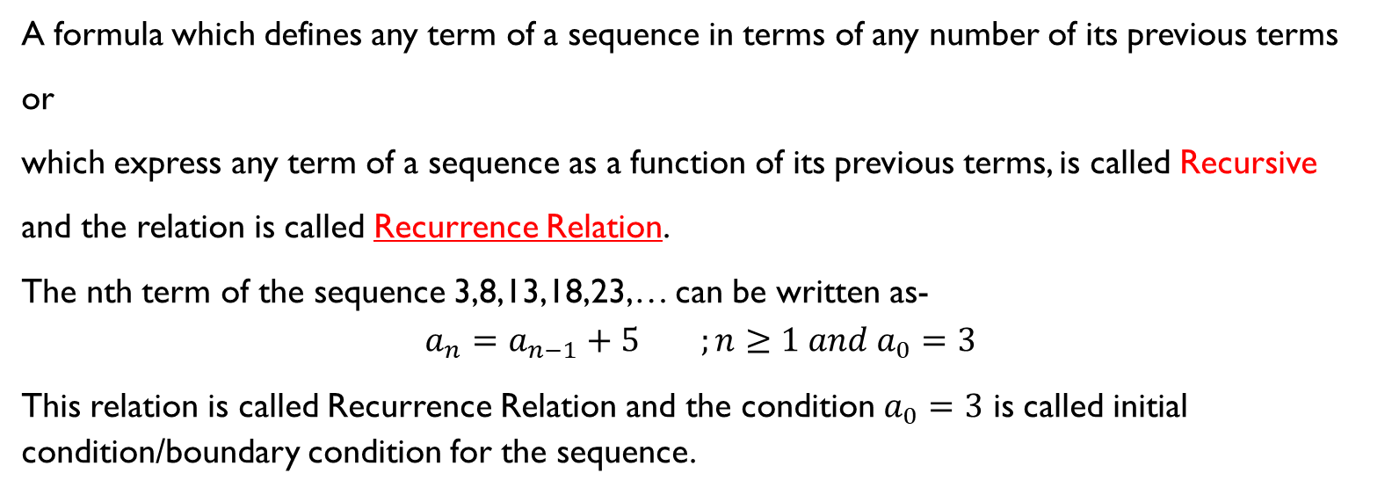
Recurrence Relation (RR)
A formula which defines any term of a sequence in terms of any number of its previous terms
or
which express any term of a sequence as a function of its previous terms, is called Recursive
and the relation is called Recurrence Relation.
The nth term of the sequence 3,8,13,18,23,… can be written as-
$$a_{n}=a_{n−1}+5 ;n≥1 and a_{0}=3$$
This relation is called Recurrence Relation and the condition $a_{0}=3$ is called initial condition/boundary condition for the sequence.

Slide 35
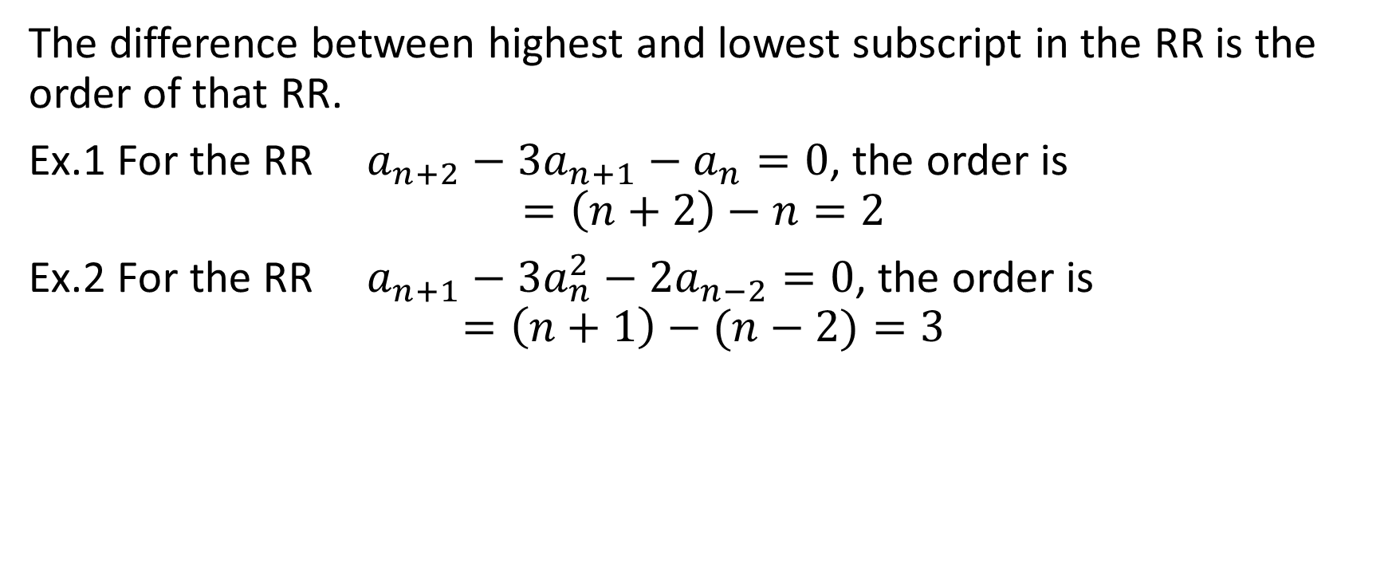
Order of the Recurrence Relation
The difference between highest and lowest subscript in the RR is the order of that RR.
Ex.1 For the RR $a_{n+2}−3a_{n+1}−a_{n}=0$, the order is
$$=\left(n+2\right)−n=2$$
Ex.2 For the RR $a_{n+1}−3a_{n}^{2}−2a_{n−2}=0$, the order is
$$=\left(n+1\right)−(n−2)=3$$

Slide 36
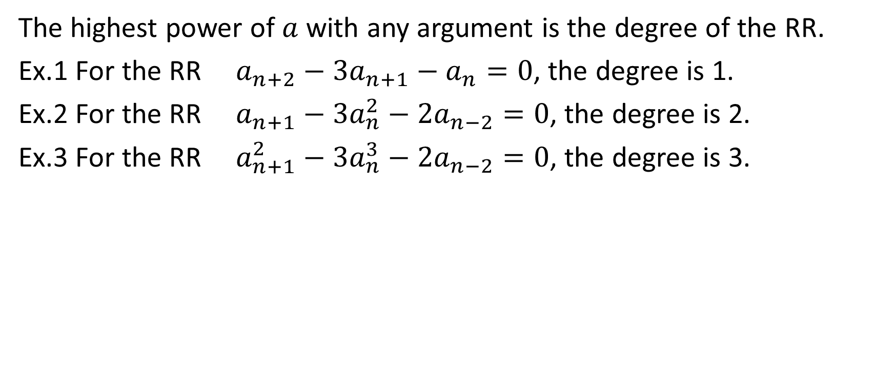
Degree of RR
The highest power of $a$ with any argument is the degree of the RR.
Ex.1 For the RR $a_{n+2}−3a_{n+1}−a_{n}=0$, the degree is 1.
Ex.2 For the RR $a_{n+1}−3a_{n}^{2}−2a_{n−2}=0$, the degree is 2.
Ex.3 For the RR $a_{n+1}^{2}−3a_{n}^{3}−2a_{n−2}=0$, the degree is 3.

Slide 37
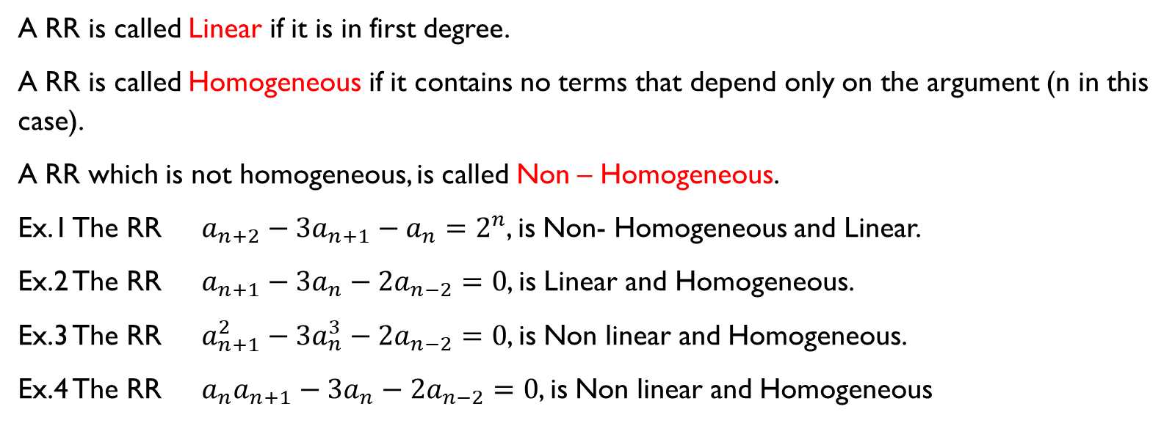
Linear and Homogeneous RR
A RR is called Linear if it is in first degree.
A RR is called Homogeneous if it contains no terms that depend only on the argument (n in this case).
A RR which is not homogeneous, is called Non – Homogeneous.
Ex.1 The RR $a_{n+2}−3a_{n+1}−a_{n}=2^{n}$, is Non- Homogeneous and Linear.
Ex.2 The RR $a_{n+1}−3a_{n}−2a_{n−2}=0$, is Linear and Homogeneous.
Ex.3 The RR $a_{n+1}^{2}−3a_{n}^{3}−2a_{n−2}=0$, is Non linear and Homogeneous.
Ex.4 The RR $a_{n}a_{n+1}−3a_{n}−2a_{n−2}=0$, is Non linear and Homogeneous

Slide 38
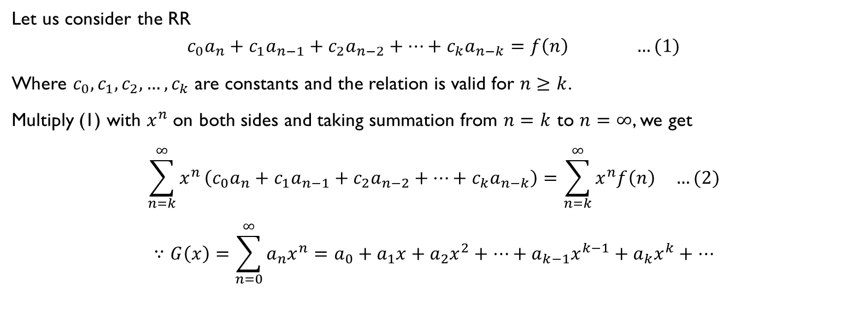
Solution of RR by GF
Let us consider the RR
$$c_{0}a_{n}+c_{1}a_{n−1}+c_{2}a_{n−2}+…+c_{k}a_{n−k}=f\left(n\right) …(1)$$
Where $c_{0},c_{1},c_{2},…,c_{k}$ are constants and the relation is valid for $n≥k$.
Multiply (1) with $x^{n}$ on both sides and taking summation from $n=k$ to $n=∞$, we get
$$\sum_{n=k}^{∞}{x^{n}}\left(c_{0}a_{n}+c_{1}a_{n−1}+c_{2}a_{n−2}+…+c_{k}a_{n−k}\right)=\sum_{n=k}^{∞}{x^{n}f\left(n\right) …(2)}$$
$$∵G\left(x\right)=\sum_{n=0}^{∞}{a_{n}x^{n}}=a_{0}+a_{1}x+a_{2}x^{2}+…+a_{k−1}x^{k−1}+a_{k}x^{k}+…$$

Slide 39

$$∴\sum_{n=k}^{∞}{a_{n}x^{n}}=\sum_{n=0}^{∞}{a_{n}x^{n}}−a_{0}−a_{1}x−a_{2}x^{2}−…−a_{k−1}x^{k−1}$$
$$∴c_{0}\sum_{n=k}^{∞}{a_{n}x^{n}}=c_{0}\left[\sum_{n=0}^{∞}{a_{n}x^{n}}−a_{0}−a_{1}x−a_{2}x^{2}−…−a_{k−1}x^{k−1}\right]$$
$$∵\sum_{n=k}^{∞}{a_{n−1}x^{n−1}}=\sum_{n=0}^{∞}{a_{n}x^{n}}−a_{0}−a_{1}x−a_{2}x^{2}−…−a_{k−2}x^{k−2}$$
$$∴c_{1}\sum_{n=k}^{∞}{a_{n−1}x^{n}}=c_{1}x\left[\sum_{n=0}^{∞}{a_{n}x^{n}}−a_{0}−a_{1}x−a_{2}x^{2}−…−a_{k−2}x^{k−2}\right]$$
Similarly

Slide 40
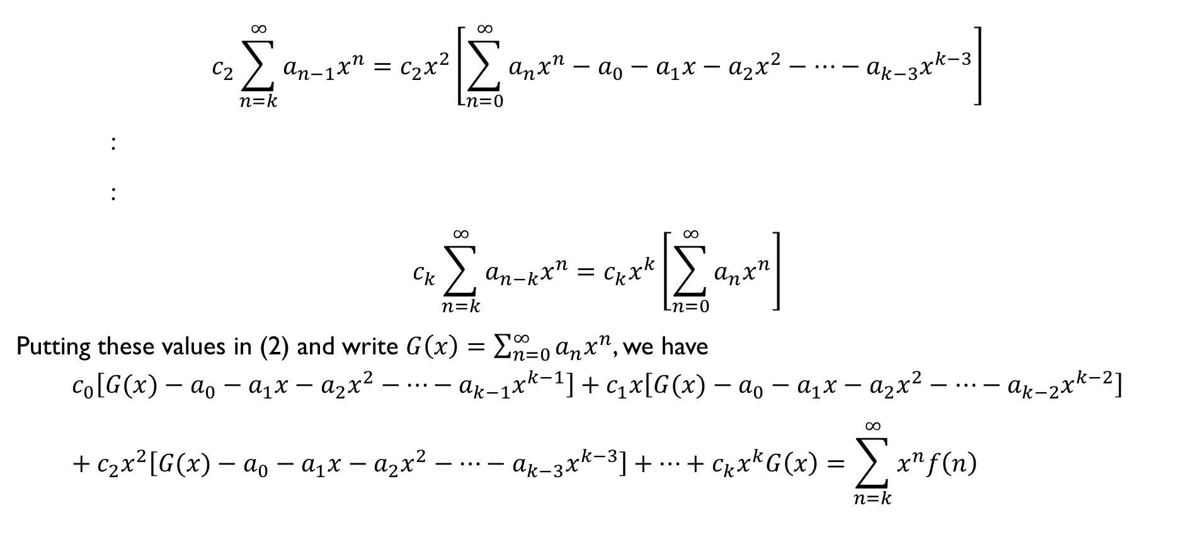
$$c_{2}\sum_{n=k}^{∞}{a_{n−1}x^{n}}=c_{2}x^{2}\left[\sum_{n=0}^{∞}{a_{n}x^{n}}−a_{0}−a_{1}x−a_{2}x^{2}−…−a_{k−3}x^{k−3}\right]$$
:
:
$$c_{k}\sum_{n=k}^{∞}{a_{n−k}x^{n}}=c_{k}x^{k}\left[\sum_{n=0}^{∞}{a_{n}x^{n}}\right]$$
Putting these values in (2) and write $G\left(x\right)=\sum_{n=0}^{∞}{a_{n}x^{n}}$, we have
$$c_{0}\left[G(x)−a_{0}−a_{1}x−a_{2}x^{2}−…−a_{k−1}x^{k−1}\right]+c_{1}x\left[G(x)−a_{0}−a_{1}x−a_{2}x^{2}−…−a_{k−2}x^{k−2}\right]+c_{2}x^{2}\left[G(x)−a_{0}−a_{1}x−a_{2}x^{2}−…−a_{k−3}x^{k−3}\right]+…+c_{k}x^{k}G\left(x\right)=\sum_{n=k}^{∞}{x^{n}f\left(n\right)}$$

Slide 41
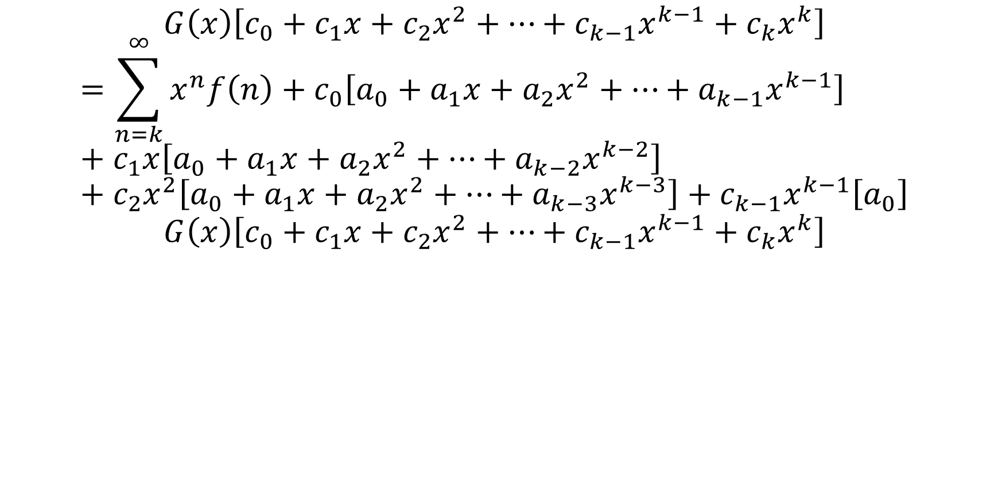
$$G\left(x\right)\left[c_{0}+c_{1}x+c_{2}x^{2}+…+c_{k−1}x^{k−1}+c_{k}x^{k}\right]$$
$$=\sum_{n=k}^{∞}{x^{n}f\left(n\right)}+c_{0}\left[a_{0}+a_{1}x+a_{2}x^{2}+…+a_{k−1}x^{k−1}\right]+c_{1}x\left[a_{0}+a_{1}x+a_{2}x^{2}+…+a_{k−2}x^{k−2}\right]+c_{2}x^{2}\left[a_{0}+a_{1}x+a_{2}x^{2}+…+a_{k−3}x^{k−3}\right]+c_{k−1}x^{k−1}\left[a_{0}\right]$$
$$G\left(x\right)\left[c_{0}+c_{1}x+c_{2}x^{2}+…+c_{k−1}x^{k−1}+c_{k}x^{k}\right]$$

Slide 42
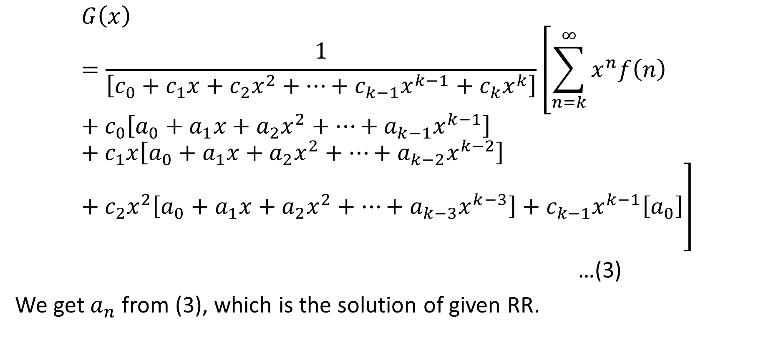
$$G\left(x\right)=\frac{1}{\left[c_{0}+c_{1}x+c_{2}x^{2}+…+c_{k−1}x^{k−1}+c_{k}x^{k}\right]}\left[\sum_{n=k}^{∞}{x^{n}f\left(n\right)}+c_{0}\left[a_{0}+a_{1}x+a_{2}x^{2}+…+a_{k−1}x^{k−1}\right]+c_{1}x\left[a_{0}+a_{1}x+a_{2}x^{2}+…+a_{k−2}x^{k−2}\right]+c_{2}x^{2}\left[a_{0}+a_{1}x+a_{2}x^{2}+…+a_{k−3}x^{k−3}\right]+c_{k−1}x^{k−1}\left[a_{0}\right]\right]$$
…(3)
We get $a_{n}$ from (3), which is the solution of given RR.

Slide 43
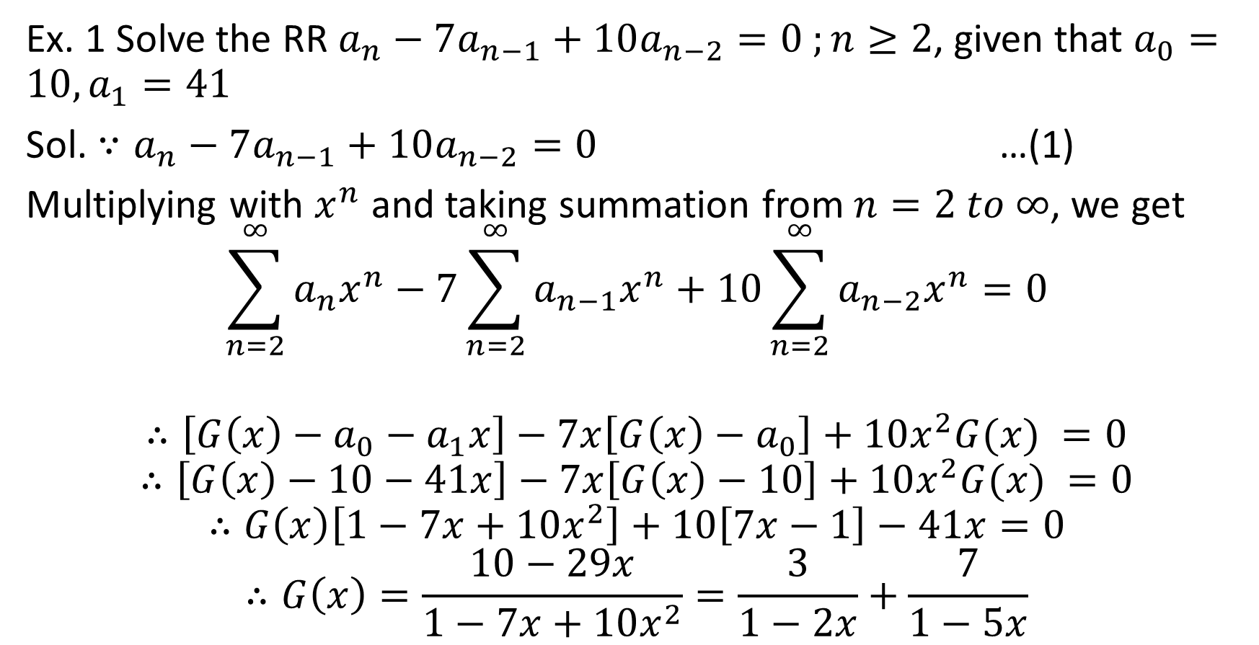
Ex. 1 Solve the RR $a_{n}−7a_{n−1}+10a_{n−2}=0 ;n≥2$, given that $a_{0}=10, a_{1}=41$
Sol. $∵a_{n}−7a_{n−1}+10a_{n−2}=0$ …(1)
Multiplying with $x^{n}$ and taking summation from $n=2 to ∞$, we get
$$\sum_{n=2}^{∞}{a_{n}x^{n}}−7\sum_{n=2}^{∞}{a_{n−1}x^{n}+10}\sum_{n=2}^{∞}{a_{n−2}x^{n}}=0$$
$$∴\left[G\left(x\right)−a_{0}−a_{1}x\right]−7x\left[G\left(x\right)−a_{0}\right]+10x^{2}G(x) =0$$
$$∴\left[G\left(x\right)−10−41x\right]−7x\left[G\left(x\right)−10\right]+10x^{2}G(x) =0$$
$$∴G\left(x\right)\left[1−7x+10x^{2}\right]+10\left[7x−1\right]−41x=0$$
$$∴G\left(x\right)=\frac{10−29x}{1−7x+10x^{2}}=\frac{3}{1−2x}+\frac{7}{1−5x}$$

Slide 44

$$\sum_{n=0}^{∞}{a_{n}x^{n}}=3\sum_{n=0}^{∞}{{2^{n}x}^{n}}+7\sum_{n=0}^{∞}{{5^{n}x}^{n}}$$
$$∴a_{n}=3.2^{n}+7.5^{n}$$

